Slide 1


Slide 2

AMANDA INTERNATIONAL PRIVATE LIMITED
FLAT/RM B 5/F GAYLORD COMMERCIAL BUILDING 114-118 LOCKHART ROAD HK
TEL:+86-15842046996 EMAIL:SALES01@AMANDA.NET.CN
PRODUCT CALALOGUE I. CERAMIC MATERIAL II. REFRACTORY MATERIAL III. MAGNESITE PRODUCT Ⅳ. CELLULOSE PRODUCTS Ⅴ. SODIUM TRIPOLYPHOSPHATE Ⅶ. POLISHING PRODUCTS

Slide 3
AMANDA INTERNATIONAL PRIVATE LIMITED
FLAT/RM B 5/F GAYLORD COMMERCIAL BUILDING 114-118 LOCKHART ROAD HK
TEL:+86-15842046996 EMAIL:SALES01@AMANDA.NET.CN
PRODUCT CALALOGUE I. CERAMIC MATERIAL 01 WOLLASTONITE (Can be customized upon request ) 02 CALCINED TALC 03 TALC 04 LOW Fe2O3 DOLOMITE 05 ALUMINA BALL 06 DIOPSIDE 07 CERAMIC BRIGHTENER 08 KAOLIN

Slide 4
AMANDA INTERNATIONAL PRIVATE LIMITED
FLAT/RM B 5/F GAYLORD COMMERCIAL BUILDING 114-118 LOCKHART ROAD HK
TEL:+86-15842046996 EMAIL:SALES01@AMANDA.NET.CN
PRODUCT CALALOGUE 09 POTASSIUM FELDSPAR 10 NEPHELINE 11 BARIUM CARBONATE 12 BENTONITE

Slide 5
AMANDA INTERNATIONAL PRIVATE LIMITED
FLAT/RM B 5/F GAYLORD COMMERCIAL BUILDING 114-118 LOCKHART ROAD HK
TEL:+86-15842046996 EMAIL:SALES01@AMANDA.NET.CN
PRODUCT CALALOGUE II. REFRACTORY MATERIAL 01 SILLIMANITE 02 RUTILE 03 KYANITE

Slide 6
AMANDA INTERNATIONAL PRIVATE LIMITED
FLAT/RM B 5/F GAYLORD COMMERCIAL BUILDING 114-118 LOCKHART ROAD HK
TEL:+86-15842046996 EMAIL:SALES01@AMANDA.NET.CN
PRODUCT CALALOGUE III. MAGNESITE PRODUCT 01 CAUSTIC CALCINED MAGNESITE 02 DEAD BURNED MAGNESITE Ⅳ. CELLULOSE PRODUCTS 01 SODIUM CARBOXYMETHYL CELLULOSE (CMC-AMC03) 02 SODIUM CARBOXYMETHYL CELLULOSE (CMC-AMC05) 03 SODIUM CARBOXYMETHYL CELLULOSE (CMC-AMC02)

Slide 7
AMANDA INTERNATIONAL PRIVATE LIMITED
FLAT/RM B 5/F GAYLORD COMMERCIAL BUILDING 114-118 LOCKHART ROAD HKTEL:+86-15842046996 EMAIL:SALES01@AMANDA.NET.CN
01 WOLLASTONITE
CHEMICAL ANALYSIS GRADE A-1
CHEMICAL ANALYSIS GRADE A-1B
ITEM | COMPOUND | RESULT
1 | SiO2 | 52.04
2 | Al2O3 | 0.16
3 | Fe2O3 | ＜0.35
4 | TiO2 | 0.01
5 | CaO | ＞43
6 | MgO | 1.46
7 | K2O | 0.02
8 | Na2O | 0.08
9 | LOSS (1025℃) | ＜2.5
ITEM | COMPOUND | RESULT
1 | SiO2 | 53.06
2 | Al2O3 | 0.16
3 | Fe2O3 | ＜0.3
4 | TiO2 | 0.01
5 | CaO | ＞42
6 | MgO | 1.35
7 | K2O | 0.02
8 | Na2O | 0.03
9 | LOSS (1025℃) | ＜3.0
PHYSICAL PROPERTIES
PHYSICAL PROPERTIES
ITEM | NAME OF TEST | RESULT
1 | 1200℃ Heat preservation 30 min | 72.1
2 | L * | 91.40
3 | a * | 1.00
4 | b* | 8.83
ITEM | NAME OF TEST | RESULT
1 | 1200℃ Heat preservation 30 min | 80.3
2 | L * | 93.91
3 | a * | 0.56
4 | b* | 6.04

Slide 8
AMANDA INTERNATIONAL PRIVATE LIMITED
FLAT/RM B 5/F GAYLORD COMMERCIAL BUILDING 114-118 LOCKHART ROAD HK
TEL:+86-15842046996 EMAIL:SALES01@AMANDA.NET.CN
01 WOLLASTONITE
CHEMICAL ANALYSIS GRADE A-2
CHEMICAL ANALYSIS GRADE A-3A
ITEM | COMPOUND | RESULT
1 | SiO2 | 60.50
2 | Al2O3 | 0.12
3 | Fe2O3 | ＜0.20
4 | TiO2 | 0.01
5 | CaO | ＞ 36
6 | MgO | 0.58
7 | K2O | 0.02
8 | Na2O | ＜0.01
9 | LOSS (1025℃) | ＜ 1.5
ITEM | COMPOUND | RESULT
1 | SiO2 | 49.53
2 | Al2O3 | 0.09
3 | Fe2O3 | ＜0.15
4 | TiO2 | 0.01
5 | CaO | ＞ 43
6 | MgO | 1.39
7 | K2O | 0.03
8 | Na2O | ＜0.01
9 | LOSS (1025℃) | ＜ 4.0
PHYSICAL PROPERTIES
PHYSICAL PROPERTIES
ITEM | NAME OF TEST | RESULT
1 | 1200℃ Heat preservation 30 min | 82.0
2 | L * | 94.04
3 | a * | 0.53
4 | b* | 4.39
ITEM | NAME OF TEST | RESULT
1 | 1200℃ Heat preservation 30 min | 85.6
2 | L * | 94.00
3 | a * | 1.91
4 | b* | 2.43

Slide 9
AMANDA INTERNATIONAL PRIVATE LIMITED
FLAT/RM B 5/F GAYLORD COMMERCIAL BUILDING 114-118 LOCKHART ROAD HK
WEBSITE:Https://amanda0a.en.made-in-china.com EMAIL:SALES01@AMANDA.NET.CN
02 CALCINED TALC
CHEMICAL ANALYSIS
ITEM | COMPOUND | RESULT
1 | LOI | 0.04
2 | Al2O3 | 1.18
3 | SiO2 | 65.07
4 | Fe2O3 | 0.13
5 | CaO | 1.04
6 | MgO | 31.93
7 | K2O | 0.12
8 | Na2O | 0.16
9 | TiO2 | 0.03
PHYSICAL PROPERTIES
ITEM | NAME OF TEST | RESULT
1 | 1200℃ Heat preservation 30 min | 92.7

Slide 10
AMANDA INTERNATIONAL PRIVATE LIMITED
FLAT/RM B 5/F GAYLORD COMMERCIAL BUILDING 114-118 LOCKHART ROAD HK
WEBSITE:Https://amanda0a.en.made-in-china.com EMAIL:SALES01@AMANDA.NET.CN
03 TALC
CHEMICAL ANALYSIS TALC-A
CHEMICAL ANALYSIS TALC-B
ITEM | COMPOUND | RESULT
1 | LOI | 7.18
2 | Al2O3 | 0.03
3 | SiO2 | 59.46
4 | Fe2O3 | 0.08
5 | CaO | 1.54
6 | MgO | 31.71
ITEM | COMPOUND | RESULT
1 | LOI | 6.56
2 | Al2O3 | 0.38
3 | SiO2 | 59.36
4 | Fe2O3 | 0.33
5 | CaO | 1.68
6 | MgO | 31.36
PHYSICAL PROPERTIES
PHYSICAL PROPERTIES
ITEM | NAME OF TEST | RESULT
1 | 1200℃ Heat preservation 30 min | 90.4
ITEM | NAME OF TEST | RESULT
1 | 1200℃ Heat preservation 30 min | 85.8

Slide 11
AMANDA INTERNATIONAL PRIVATE LIMITED
FLAT/RM B 5/F GAYLORD COMMERCIAL BUILDING 114-118 LOCKHART ROAD HK
WEBSITE:Https://amanda0a.en.made-in-china.com EMAIL:SALES01@AMANDA.NET.CN
04 DOLOMITE （low Fe2O3 content for glass industry)
CHEMICAL ANALYSIS
No. | Test Item |  | RESULT
1 | LOSS(1025℃） |  | 46.93%
2 | Al2O3 |  | ＜0.01%
3 | SiO2 |  | 0.05%
4 | Fe2O3 |  | 0.0067%
5 | CaO |  | 32.26%
6 | MgO |  | 20.59%
7 | K₂O |  | ＜0.01%
8 | Na₂O |  | ＜0.01%
9 | TiO₂ |  | 0.01%
10 | White degree(1200℃，30min burned,blue light) |  | 95.5
11 | Color difference (1200℃，30min) | L* | 98.26
12 |  | a* | 0.59
13 |  | b* | 0.86

Slide 12
AMANDA INTERNATIONAL PRIVATE LIMITED
FLAT/RM B 5/F GAYLORD COMMERCIAL BUILDING 114-118 LOCKHART ROAD HK
WEBSITE:Https://amanda0a.en.made-in-china.com EMAIL:SALES01@AMANDA.NET.CN
05 ALUMINA BALL
CHEMICAL ANALYSIS 68% ALUMINA BALL 60MM
ITEM | COMPOUND |  | RESULT
1 | ABRASION | Weight Before Grinding | 4021 (g)
 |  | Weight After Grinding | 3992 (g)
 |  | Avarage Diameter | 60.47 (mm)
 |  | Current Abrasion | 0.182 (‰）
2 | BULK DENSITY |  | 3.01 (g/cm3)
3 | Al2O3 |  | 69.95

Slide 13
AMANDA INTERNATIONAL PRIVATE LIMITED
FLAT/RM B 5/F GAYLORD COMMERCIAL BUILDING 114-118 LOCKHART ROAD HK
WEBSITE:Https://amanda0a.en.made-in-china.com EMAIL:SALES01@AMANDA.NET.CN
05 ALUMINA BALL
CHEMICAL ANALYSIS 68% ALUMINA BALL 50MM
ITEM | COMPOUND |  | RESULT
1 | ABRASION | Weight Before Grinding | 4004 (g)
 |  | Weight After Grinding | 3970 (g)
 |  | Avarage Diameter | 52.16 (mm)
 |  | Current Abrasion | 0.185 (‰）

Slide 14
AMANDA INTERNATIONAL PRIVATE LIMITED
FLAT/RM B 5/F GAYLORD COMMERCIAL BUILDING 114-118 LOCKHART ROAD HK
WEBSITE:Https://amanda0a.en.made-in-china.com EMAIL:SALES01@AMANDA.NET.CN
05 ALUMINA BALL
CHEMICAL ANALYSIS 68% ALUMINA BALL 40MM
ITEM | COMPOUND |  | RESULT
1 | ABRASION | Weight Before Grinding | 4002 (g)
 |  | Weight After Grinding | 3962 (g)
 |  | Avarage Diameter | 41.99 (mm)
 |  | Current Abrasion | 0.175 (‰）

Slide 15
AMANDA INTERNATIONAL PRIVATE LIMITED
FLAT/RM B 5/F GAYLORD COMMERCIAL BUILDING 114-118 LOCKHART ROAD HK
WEBSITE:Https://amanda0a.en.made-in-china.com EMAIL:SALES01@AMANDA.NET.CN
05 ALUMINA BALL
CHEMICAL ANALYSIS 68% ALUMINA BALL 30MM
ITEM | COMPOUND |  | RESULT
1 | ABRASION | Weight Before Grinding | 4015 (g)
 |  | Weight After Grinding | 3978 (g)
 |  | Avarage Diameter | 37.79 (mm)
 |  | Current Abrasion | 0.145 (‰）

Slide 16
AMANDA INTERNATIONAL PRIVATE LIMITED
FLAT/RM B 5/F GAYLORD COMMERCIAL BUILDING 114-118 LOCKHART ROAD HK
TEL:+86-15842046996 EMAIL:SALES01@AMANDA.NET.CN
05 ALUMINA BALL
CHEMICAL ANALYSIS 92%
ITEM | COMPOUND | RESULT
1 | SiO2 | 30.75
2 | Al2O3 | 40.09
3 | Fe2O3 | 0.28
4 | TiO2 | 0.04
5 | CaO | 0.21
6 | MgO | 0.09
7 | K2O | 0.45
8 | Na2O | 1.43
9 | Zr(Hf)O2 | 24.27
10 | LOI | 2.09
ITEM | NAME OF TEST | RESULT
1 | Shrinkage % | 6.48
2 | LOI | 1.34
3 | Residue 300#% | 0.08
4 | L* | 92.84
5 | a* | -0.26
6 | b* | 5.85
7 | Whiteness | 83.14
8 | Temperature C | 1192/1208
9 | Cycle Min. | 43

Slide 17
AMANDA INTERNATIONAL PRIVATE LIMITED
FLAT/RM B 5/F GAYLORD COMMERCIAL BUILDING 114-118 LOCKHART ROAD HK
WEBSITE:Https://amanda0a.en.made-in-china.com EMAIL:SALES01@AMANDA.NET.CN
06 DIOPSIDE
CHEMICAL ANALYSIS DIOPSIDE
ITEM | COMPOUND | RESULT
1 | SiO2 | 63.84
2 | Al2O3 | 0.56
3 | Fe2O3 | 0.23
4 | TiO2 | 0.02
5 | CaO | 18.80
6 | MgO | 13.38
7 | K2O | 0.19
8 | Na2O | 0.16
9 | LOSS (1025℃) | 2.65
PHYSICAL PROPERTIES
ITEM | NAME OF TEST | RESULT
1 | 1200℃ Heat preservation 30 min | 87.5
2 | L * | 91.40
3 | a * | 1.00
4 | b* | 8.83

Slide 18
AMANDA INTERNATIONAL PRIVATE LIMITED
FLAT/RM B 5/F GAYLORD COMMERCIAL BUILDING 114-118 LOCKHART ROAD HK
WEBSITE:Https://amanda0a.en.made-in-china.com EMAIL:SALES01@AMANDA.NET.CN
07 KAOLIN
CHEMICAL ANALYSIS CALCINED KAOLIN
ITEM | COMPOUND | RESULT
1 | LOSS | 0.14
2 | Al2O3 | 45.54
3 | SiO2 | 51.77
4 | Fe2O3 | 0.52
5 | CaO | 0.24
6 | MgO | 0.12
7 | K2O | 0.11
8 | Na2O | 0.04
9 | TiO2 | 1.23
PHYSICAL PROPERTIES
ITEM | NAME OF TEST | RESULT
1 | 1200℃ Heat preservation 30 min | 94.3
2 | L * | 97.51
3 | a * | 1.52
4 | b* | 0.98

Slide 19
AMANDA INTERNATIONAL PRIVATE LIMITED
FLAT/RM B 5/F GAYLORD COMMERCIAL BUILDING 114-118 LOCKHART ROAD HK
WEBSITE:Https://amanda0a.en.made-in-china.com EMAIL:SALES01@AMANDA.NET.CN
07 KAOLIN
CHEMICAL ANALYSIS WASHED KAOLIN
PLASTICITY INDEX
ITEM | COMPOUND | RESULT
1 | LOSS | 13.18
2 | Al2O3 | 37.08
3 | SiO2 | 48.33
4 | Fe2O3 | 0.37
5 | CaO | 0.01
6 | MgO | 0.03
7 | K2O | 0.44
8 | Na2O | 0.01
9 | TiO2 | 0.41
10 | 1200℃x30min After Burning, Blue Light Whiteness | 91.2
11 | 1200℃x30min After Burning, Wet Water,Blue Light Whiteness | 78.9
ITEM | COMPOUND | RESULT
1 | Liquid Limit | 62.15
2 | Plastic Limit | 29.10
3 | Plasticity Index | 33.05
FLOW VELOCITY
ITEM | COMPOUND | RESULT
1 | Sample Weight | 200g
2 | Water Weight | 100g
3 | STPP | 1g
4 | Ball Milling Tme | 10 min
5 | Flow Velocity | 28s

Slide 20
AMANDA INTERNATIONAL PRIVATE LIMITED
FLAT/RM B 5/F GAYLORD COMMERCIAL BUILDING 114-118 LOCKHART ROAD HK
WEBSITE:Https://amanda0a.en.made-in-china.com EMAIL:SALES01@AMANDA.NET.CN
08 CERAMIC BRIGHTENER
CHEMICAL ANALYSIS ZB-1
ITEM | COMPOUND | RESULT
1 | LOSS (1025℃) | 0.12
2 | Al2O3 | 1.20
3 | SiO2 | 98.07
4 | Fe2O3 | 0.062
5 | CaO | 0.05
6 | MgO | ＜0.01
7 | K2O | 0.36
8 | Na2O | 0.02
9 | TiO2 | 0.03
PHYSICAL PROPERTIES
ITEM | NAME OF TEST | RESULT
1 | 1200℃ Heat preservation 30 min | 87.4
2 | L * | 94.43
3 | a * | 1.05
4 | b* | 1.67

Slide 21
AMANDA INTERNATIONAL PRIVATE LIMITED
FLAT/RM B 5/F GAYLORD COMMERCIAL BUILDING 114-118 LOCKHART ROAD HK
WEBSITE:Https://amanda0a.en.made-in-china.com EMAIL:SALES01@AMANDA.NET.CN
08 CERAMIC BRIGHTENER
CHEMICAL ANALYSIS ZB-2
ITEM | COMPOUND | RESULT
1 | LOSS (1025℃) | 0.28
2 | Al2O3 | 40.03
3 | SiO2 | 59.75
4 | Fe2O3 | 0.08
5 | CaO | 0.05
6 | MgO | 0.03
7 | K2O | 0.12
8 | Na2O | 0.11
9 | TiO2 | 0.30

Slide 22
AMANDA INTERNATIONAL PRIVATE LIMITED
FLAT/RM B 5/F GAYLORD COMMERCIAL BUILDING 114-118 LOCKHART ROAD HK
WEBSITE:Https://amanda0a.en.made-in-china.com EMAIL:customer@amanda.net.cn
09 POTASSIUM FELDSPAR
ANALYSIS REPORT
NO. | ITEM |  | RESULT
1 | LOSS (1025℃) |  | 0.15
2 | Al2O3 |  | 18.41
3 | SiO2 |  | 66.40
4 | Fe2O3 |  | 0.03
5 | CaO |  | 0.19
6 | MgO |  | ＜0.01
7 | K2O |  | 11.90
8 | Na2O |  | 2.72
9 | TiO2 |  | 0.02
10 | Whiteness(1200℃×30min,blue light) |  | 61.7
11 | Firing shrinkage |  | 16.65
12 | 1200℃×30min | L* | 78.26
13 |  | a* | 1.72
14 |  | b* | 2.92

Slide 23
AMANDA INTERNATIONAL PRIVATE LIMITED
FLAT/RM B 5/F GAYLORD COMMERCIAL BUILDING 114-118 LOCKHART ROAD HK
WEBSITE:Https://amanda0a.en.made-in-china.com EMAIL:customer@amanda.net.cn
09 POTASSIUM FELDSPAR(01)
ANALYSIS REPORT
NO. | ITEM |  | RESULT
1 | LOSS (1025℃) |  | 0.45
2 | Al2O3 |  | 17.03
3 | SiO2 |  | 68.27
4 | Fe2O3 |  | 0.12
5 | CaO |  | 0.56
6 | MgO |  | 0.24
7 | K2O |  | 11.95
8 | Na2O |  | 2.25
9 | TiO2 |  | 0.02
10 | Whiteness（1200℃，45min) |  | 69.51
11 | shrinkage |  | 11.29
12 | 1200℃×45min | L* | 86.73
13 |  | a* | 2.02
14 |  | b* | 2.9
15 | residue 200#% |  | 0.38

Slide 24
AMANDA INTERNATIONAL PRIVATE LIMITED
FLAT/RM B 5/F GAYLORD COMMERCIAL BUILDING 114-118 LOCKHART ROAD HK
WEBSITE:Https://amanda0a.en.made-in-china.com EMAIL:customer@amanda.net.cn
09 POTASSIUM FELDSPAR(02)
ANALYSIS REPORT
NO. | ITEM |  | RESULT
1 | LOSS (1025℃) |  | 0.23
2 | Al2O3 |  | 15.98
3 | SiO2 |  | 70.07
4 | Fe2O3 |  | 0.09
5 | CaO |  | 0.28
6 | MgO |  | 0.1
7 | K2O |  | 10.05
8 | Na2O |  | 2.38
9 | TiO2 |  | 0.02
10 | Whiteness（1200℃，45min) |  | 71.64
11 | shrinkage |  | 8.34
12 | 1200℃×45min | L* | 87.79
13 |  | a* | 2.42
14 |  | b* | 3.12
15 | residue 200#% |  | 1.28

Slide 25
AMANDA INTERNATIONAL PRIVATE LIMITED
FLAT/RM B 5/F GAYLORD COMMERCIAL BUILDING 114-118 LOCKHART ROAD HK
WEBSITE:Https://amanda0a.en.made-in-china.com EMAIL:customer@amanda.net.cn
09 POTASSIUM FELDSPAR(03)
ANALYSIS REPORT
NO. | ITEM |  | RESULT
1 | LOSS (1025℃) |  | 0.41
2 | Al2O3 |  | 15.74
3 | SiO2 |  | 70.21
4 | Fe2O3 |  | 0.17
5 | CaO |  | 0.38
6 | MgO |  | 0.18
7 | K2O |  | 9.85
8 | Na2O |  | 2.69
9 | TiO2 |  | 0.03
10 | Whiteness（1200℃，45min) |  | 49.18
11 | shrinkage |  | 14.51
12 | 1200℃×45min | L* | 75.51
13 |  | a* | 4.3
14 |  | b* | 4.52
15 | residue 200#% |  | 0.15

Slide 26
AMANDA INTERNATIONAL PRIVATE LIMITED
FLAT/RM B 5/F GAYLORD COMMERCIAL BUILDING 114-118 LOCKHART ROAD HK
WEBSITE:Https://amanda0a.en.made-in-china.com EMAIL:customer@amanda.net.cn
09 POTASSIUM FELDSPAR(04)
ANALYSIS REPORT
NO. | ITEM |  | RESULT
1 | LOSS (1025℃) |  | 0.39
2 | Al2O3 |  | 15.72
3 | SiO2 |  | 70.24
4 | Fe2O3 |  | 0.12
5 | CaO |  | 0.39
6 | MgO |  | 0.15
7 | K2O |  | 10.19
8 | Na2O |  | 2.52
9 | TiO2 |  | 0.02
10 | Whiteness（1200℃，45min) |  | 64.36
11 | shrinkage |  | 11.13
12 | 1200℃×45min | L* | 84.52
13 |  | a* | 2.6
14 |  | b* | 3.73
15 | residue 200#% |  | 0.1

Slide 27
AMANDA INTERNATIONAL PRIVATE LIMITED
FLAT/RM B 5/F GAYLORD COMMERCIAL BUILDING 114-118 LOCKHART ROAD HK
WEBSITE:Https://amanda0a.en.made-in-china.com EMAIL:customer@amanda.net.cn
09 POTASSIUM FELDSPAR(05)
ANALYSIS REPORT
NO. | ITEM |  | RESULT
1 | LOSS (1025℃) |  | 0.23
2 | Al2O3 |  | 15.21
3 | SiO2 |  | 70.79
4 | Fe2O3 |  | 0.09
5 | CaO |  | 0.31
6 | MgO |  | 0.11
7 | K2O |  | 11.41
8 | Na2O |  | 2.42
9 | TiO2 |  | 0.03
10 | Whiteness（1200℃，45min) |  | 77.17
11 | shrinkage |  | 8.41
12 | 1200℃×45min | L* | 90.69
13 |  | a* | 1.88
14 |  | b* | 2.42
15 | residue 200#% |  | 0.84

Slide 28
AMANDA INTERNATIONAL PRIVATE LIMITED
FLAT/RM B 5/F GAYLORD COMMERCIAL BUILDING 114-118 LOCKHART ROAD HK
WEBSITE:Https://amanda0a.en.made-in-china.com EMAIL:customer@amanda.net.cn
09 POTASSIUM FELDSPAR(06)
ANALYSIS REPORT
NO. | ITEM |  | RESULT
1 | LOSS (1025℃) |  | 0.24
2 | Al2O3 |  | 16.02
3 | SiO2 |  | 70.15
4 | Fe2O3 |  | 0.1
5 | CaO |  | 0.26
6 | MgO |  | 0.1
7 | K2O |  | 10.97
8 | Na2O |  | 2.31
9 | TiO2 |  | 0.02
10 | Whiteness（1200℃，45min) |  | 75.71
11 | shrinkage |  | 8.06
12 | 1200℃×45min | L* | 89.58
13 |  | a* | 1.75
14 |  | b* | 3.16
15 | residue 200#% |  | 0.73

Slide 29
AMANDA INTERNATIONAL PRIVATE LIMITED
FLAT/RM B 5/F GAYLORD COMMERCIAL BUILDING 114-118 LOCKHART ROAD HK
WEBSITE:Https://amanda0a.en.made-in-china.com EMAIL:customer@amanda.net.cn
10 NEPHELINE
CHEMICAL ANALYSIS
ITEM | COMPOUND |  | RESULT
1 | LOSS (1025℃) |  | 2.32
2 | Al2O3 |  | 20.85
3 | SiO2 |  | 62.17
4 | Fe2O3 |  | 0.11
5 | CaO |  | 0.24
6 | MgO |  | 0.02
7 | K2O |  | 5.43
8 | Na2O |  | 8.61
9 | TiO2 |  | 0.07
10 | Whiteness(1200℃×30min,blue light) |  | 52.4
11 | Firing shrinkage |  | 11.94
12 | 1200℃×30min | L* | 70.95
13 |  | a* | -0.14
14 |  | b* | 4.45

Slide 30
AMANDA INTERNATIONAL PRIVATE LIMITED
FLAT/RM B 5/F GAYLORD COMMERCIAL BUILDING 114-118 LOCKHART ROAD HK
WEBSITE:Https://amanda0a.en.made-in-china.com EMAIL:customer@amanda.net.cn
11 BARIUM CARBONATE (Z)
ANALYSIS REPORT
ITEM | SPECIFICATION | RESULT
Apperance | White | White powder
BaCO3 content% | ≥99.00 | 99.55
Moisture | ≤0.30 | 0.040
HCI insoluble matters | ≤0.10 | 0.039
S²⁻ | ≤0.10 | 0.047
SO₄²⁻ | ≤0.25 | 0.16
Bulk Density | 1.3-1.9 | 1.64
Iron(Fe) | ≤0.0020 | 0.00063
Fineness | （μm） | 14.86

Slide 31
AMANDA INTERNATIONAL PRIVATE LIMITED
FLAT/RM B 5/F GAYLORD COMMERCIAL BUILDING 114-118 LOCKHART ROAD HK
WEBSITE:Https://amanda0a.en.made-in-china.com EMAIL:customer@amanda.net.cn
11 BARIUM CARBONATE (Q)
ANALYSIS REPORT
ITEM | COMPOUND | RESULT
1 | LOSS (1025℃) | 2.32
2 | Al2O3 | 20.85
3 | SiO2 | 62.17
4 | Fe2O3 | 0.11
5 | CaO | 0.24
6 | MgO | 0.02
7 | K2O | 5.43
8 | Na2O | 8.61
9 | TiO2 | 0.07
ITEM | SPECIFICATION | RESULT
Apperance | White | White powder
BaCO3 content% | ≥99.00 | 99.62
Moisture | ≤0.30 | 0.047
HCI insoluble matters | ≤0.10 | 0.040
S²⁻ | ≤0.10 | 0.050
SO₄²⁻ | ≤0.30 | 0.17
Bulk Density(g/ml) |  | 1.10
Iron(Fe) | ≤0.0020 | 0.00058
44μm sieve residue% | ≤1.0 | 0.10
Fineness | （μm） | 3.13

Slide 32
AMANDA INTERNATIONAL PRIVATE LIMITED
FLAT/RM B 5/F GAYLORD COMMERCIAL BUILDING 114-118 LOCKHART ROAD HK
WEBSITE:Https://amanda0a.en.made-in-china.com EMAIL:customer@amanda.net.cn
12 BENTONITE (L02)
ANALYSIS REPORT
NO. | ITEM | RESULT
1 | LOSS | 11.5
2 | Al2O3 | 14.38
3 | SiO2 | 70.58
4 | Fe2O3 | 0.55
5 | CaO | 0.58
6 | MgO | 0.36
7 | K2O | 0.99
8 | Na2O | 0.6
9 | Water of Plasticity% | 78
10 | Forming Pressure Kg/cm² | 300
11 | shrinkage | 14.24
12 | L* | 82.65
13 | a* | -0.28
14 | b* | 7.77
15 | Dry MOR Kg/cm² | 36.8
16 | Fired MOR Kg/cm² | 167.2
17 | Water Absorption% | 0.45

Slide 33
AMANDA INTERNATIONAL PRIVATE LIMITED
FLAT/RM B 5/F GAYLORD COMMERCIAL BUILDING 114-118 LOCKHART ROAD HK
WEBSITE:Https://amanda0a.en.made-in-china.com EMAIL:customer@amanda.net.cn
12 BENTONITE (L00)
ANALYSIS REPORT
NO. | ITEM | RESULT
1 | LOI | 8±1
2 | Al2O3 | 14±2
3 | SiO2 | 68±2
4 | Fe2O3 | 1.3±0.2
5 | TiO2 | 0.4±0.1
6 | Alkali content | 8.0±1.0
7 | Plasticity | 65±4
8 | MOR(kg/cm²) | --
9 | Firing L value（1200℃) | 80±0.8
10 | shrinkage | 12.0±1.0
11 | residue on 325#% | ≤1

Slide 34
AMANDA INTERNATIONAL PRIVATE LIMITED
FLAT/RM B 5/F GAYLORD COMMERCIAL BUILDING 114-118 LOCKHART ROAD HK
WEBSITE:Https://amanda0a.en.made-in-china.com EMAIL:customer@amanda.net.cn
12 BENTONITE (W61)
ANALYSIS REPORT
NO. | ITEM | RESULT
1 | TiO2 | 0.06
2 | Al2O3 | 14.41
3 | SiO2 | 73.28
4 | Fe2O3 | 1.14
5 | CaO | 1.43
6 | MgO | 2.01
7 | K2O | 1.1
8 | Na2O | 1.15
9 | Water of Plasticity% | 68.4
10 | shrinkage | 9.09
11 | L* | 82.68
12 | a* | 0.2
13 | b* | 11.15
14 | Dry MOR Kg/cm² | 59.4
15 | Fired MOR Kg/cm² | 201.3
16 | Water Absorption% | 2.56
17 | T.D.S | 340
18 | Residue 300#% | 2.81
19 | Whiteness | 61.6
20 | Temperature ℃ | 1195/1207
21 | Cycle Min. | 45
22 | LOSS on lgnition% | 5.09

Slide 35
AMANDA INTERNATIONAL PRIVATE LIMITED
FLAT/RM B 5/F GAYLORD COMMERCIAL BUILDING 114-118 LOCKHART ROAD HK
WEBSITE:Https://amanda0a.en.made-in-china.com EMAIL:customer@amanda.net.cn
12 BENTONITE (W76)
ANALYSIS REPORT
10 | Water of Plasticity% | 71.2
11 | Whiteness | 76.34
12 | shrinkage | 8.94
13 | L* | 89.99
14 | a* | -0.32
15 | b* | 7.53
16 | Dry MOR Kg/cm² | 64.8
17 | Fired MOR Kg/cm² | 188.7
18 | Water Absorption% | 2.68
19 | T.D.S | 340
20 | Residue 300#% | 0.12
21 | Temperature ℃ | 1195/1207
22 | Cycle Min. | 45
NO. | ITEM | RESULT
1 | LOSS | 5.33
2 | Al2O3 | 13.64
3 | SiO2 | 73.58
4 | Fe2O3 | 0.69
5 | CaO | 1.1
6 | MgO | 2.81
7 | K2O | 1.12
8 | Na2O | 0.63
9 | TiO2 | 0.05

Slide 36
AMANDA INTERNATIONAL PRIVATE LIMITED
FLAT/RM B 5/F GAYLORD COMMERCIAL BUILDING 114-118 LOCKHART ROAD HK
TEL:+86-15842046996 EMAIL:SALES01@AMANDA.NET.CN
II. REFRACTORY MATERIAL
01 SILLIMANITE
CHEMICAL ANALYSIS SILLIMANITE
ITEM | COMPOUND | RESULT
1 | Al2O3 | 55
2 | Fe2O3 | 1.02
3 | SiO2 | 38.5
4 | K2O | 0.75
5 | Na2O | 0.08
6 | TiO2 | 1.05
7 | Size | 325mesh 98%

Slide 37
AMANDA INTERNATIONAL PRIVATE LIMITED
FLAT/RM B 5/F GAYLORD COMMERCIAL BUILDING 114-118 LOCKHART ROAD HK
TEL:+86-15842046996 EMAIL:SALES01@AMANDA.NET.CN
02 RUTILE
CHEMICAL ANALYSIS RUTILE
ITEM | COMPOUND | RESULT
1 | TiO2 | 95.46
2 | Fe2O3 | 0.84
3 | SiO2 | 1.02
4 | P | 0.017
5 | S | 0.015
6 | C | 0.014
7 | ZrO2 | 0.46
8 | H2O | 0.022

Slide 38
AMANDA INTERNATIONAL PRIVATE LIMITED
FLAT/RM B 5/F GAYLORD COMMERCIAL BUILDING 114-118 LOCKHART ROAD HK
TEL:+86-15842046996 EMAIL:SALES01@AMANDA.NET.CN
03 KYANITE
CHEMICAL ANALYSIS KYANITE
ITEM | COMPOUND | RESULT
1 | Al2O3 | 55
2 | Fe2O3 | 0.75
3 | SiO2 | 39.6
4 | K2O | 0.55
5 | Na2O | 0.08
6 | LOSS | 0.3
7 | 200mesh Pass Rate | 94.2%

Slide 39
AMANDA INTERNATIONAL PRIVATE LIMITED
FLAT/RM B 5/F GAYLORD COMMERCIAL BUILDING 114-118 LOCKHART ROAD HK
WEBSITE:Https://amanda0a.en.made-in-china.com EMAIL:SALES01@AMANDA.NET.CN
III. MAGNESITE PRODUCT
01 CAUSTIC CALCINED MAGNESITE
CHEMICAL ANALYSIS CCM - B
CHEMICAL ANALYSIS CCM - B
ITEM | COMPOUND | RESULT
1 | LOSS(℃) | 13.95
2 | SiO2 | 7.19
3 | CaO | 1.73
4 | MgO | 76.48
5 | Fe2O3 | 0.30
6 | Al2O3 | 0.35
ITEM | COMPOUND | RESULT
1 | LOSS(℃) | 5.53
2 | SiO2 | 5.41
3 | CaO | 1.51
4 | MgO | 86.70
5 | Fe2O3 | 0.28
6 | Al2O3 | 0.57
7 | PASS RATE | 92.30
8 | WHITENESS | 76.70
7 | PASS RATE | 95
8 | WHITENESS | 78

Slide 40
AMANDA INTERNATIONAL PRIVATE LIMITED
FLAT/RM B 5/F GAYLORD COMMERCIAL BUILDING 114-118 LOCKHART ROAD HK
WEBSITE:Https://amanda0a.en.made-in-china.com EMAIL:SALES01@AMANDA.NET.CN
III. MAGNESITE PRODUCT
01 CAUSTIC CALCINED MAGNESITE
CHEMICAL ANALYSIS CCM -S
CHEMICAL ANALYSIS CCM -S
ITEM | COMPOUND | RESULT
1 | LOSS(℃) | 4.97
2 | SiO2 | 6.51
3 | CaO | 1.61
4 | MgO | 86.13
5 | Fe2O3 | 0.34
6 | Al2O3 | 0.44
ITEM | COMPOUND | RESULT
1 | LOSS(℃) | 2.25
2 | SiO2 | 3.45
3 | CaO | 1.98
4 | MgO | 91.32
5 | Fe2O3 | 0.56
6 | Al2O3 | 0.44
7 | PASS RATE | 95
7 | PASS RATE | 95

Slide 41
AMANDA INTERNATIONAL PRIVATE LIMITED
FLAT/RM B 5/F GAYLORD COMMERCIAL BUILDING 114-118 LOCKHART ROAD HK
WEBSITE:Https://amanda0a.en.made-in-china.com EMAIL:SALES01@AMANDA.NET.CN
02 DEAD BURNED MAGNESITE
CHEMICAL ANALYSIS DBM LUMP
CHEMICAL ANALYSIS DBM 15-30MM
ITEM | COMPOUND | RESULT
1 | LOSS(℃) | 0.20
2 | SiO2 | 6.17
3 | CaO | 0.95
4 | MgO | 90.19
5 | Fe2O3 | 0.66
6 | Al2O3 | 1.46
ITEM | COMPOUND | RESULT
1 | LOSS(℃) | 0.05
2 | SiO2 | 5.42
3 | CaO | 1.01
4 | MgO | 90.6
5 | Fe2O3 | 0.70
6 | Al2O3 | 1.88

Slide 42
AMANDA INTERNATIONAL PRIVATE LIMITED
FLAT/RM B 5/F GAYLORD COMMERCIAL BUILDING 114-118 LOCKHART ROAD HK
WEBSITE:Https://amanda0a.en.made-in-china.com EMAIL:SALES01@AMANDA.NET.CN
02 DEAD BURNED MAGNESITE
CHEMICAL ANALYSIS DBM 5-15MM
CHEMICAL ANALYSIS DBM 3-5MM
ITEM | COMPOUND | RESULT
1 | LOSS(℃) | 0.24
2 | SiO2 | 4.56
3 | CaO | 0.98
4 | MgO | 91.22
5 | Fe2O3 | 0.68
6 | Al2O3 | 1.93
ITEM | COMPOUND | RESULT
1 | LOSS(℃) | 0.13
2 | SiO2 | 3.95
3 | CaO | 1.04
4 | MgO | 92.50
5 | Fe2O3 | 0.62
6 | Al2O3 | 1.40

Slide 43
AMANDA INTERNATIONAL PRIVATE LIMITED
FLAT/RM B 5/F GAYLORD COMMERCIAL BUILDING 114-118 LOCKHART ROAD HK
WEBSITE:Https://amanda0a.en.made-in-china.com EMAIL:SALES01@AMANDA.NET.CN
02 DEAD BURNED MAGNESITE
CHEMICAL ANALYSIS DBM 1-3MM
CHEMICAL ANALYSIS DBM 0-1MM
ITEM | COMPOUND | RESULT
1 | LOSS(℃) | 0.20
2 | SiO2 | 3.70
3 | CaO | 1.12
4 | MgO | 92.81
5 | Fe2O3 | 0.68
6 | Al2O3 | 1.05
ITEM | COMPOUND | RESULT
1 | LOSS(℃) | 0.16
2 | SiO2 | 3.47
3 | CaO | 0.98
4 | MgO | 93.22
5 | Fe2O3 | 0.76
6 | Al2O3 | 0.96

Slide 44
AMANDA INTERNATIONAL PRIVATE LIMITED
FLAT/RM B 5/F GAYLORD COMMERCIAL BUILDING 114-118 LOCKHART ROAD HK
WEBSITE:Https://amanda0a.en.made-in-china.com EMAIL:customer@amanda.net.cn
Ⅳ. CELLULOSE PRODUCTS
01 SODIUM CARBOXYMETHYL CELLULOSE(CMC)
PRODUCT CODE | AMC03 | QUALITY STANDARD | FOOD GRADE
ITEM |  | SPECIFICATION | RESULT
Appearance |  | White or Cream Color | Yes
1% Aqueous solution Brookfield viscosity (mPa.s) |  | 300-500cps | 375cps
Degree of substitution |  | 0.75 - 0.90 | 0.88
PH (1% in solutions) |  | 6.5 - 8.0 | 7.1
Loss on drying (%) |  | ≤8.0 | 6.25
Purity(%) |  | ≥99.5 | 99.85
Chloride content (as NaCl -) (%) |  | ≤0.5 | 0.11
Sodium glycolate (%) |  | ≤0.4 | 0.10
As (mg/kg) |  | ≤1.0 | Not detected
Pb (mg/kg) |  | ≤1.0 | Not detected
Hg (mg/kg) |  | ≤1.0 | Not detected
Cd (mg/kg) |  | ≤1.0 | Not detected

Slide 45
AMANDA INTERNATIONAL PRIVATE LIMITED
FLAT/RM B 5/F GAYLORD COMMERCIAL BUILDING 114-118 LOCKHART ROAD HK
WEBSITE:Https://amanda0a.en.made-in-china.com EMAIL:customer@amanda.net.cn
Ⅳ. CELLULOSE PRODUCTS
01 SODIUM CARBOXYMETHYL CELLULOSE(CMC)
PRODUCT CODE | AMC05 | QUALITY STANDARD | FOOD GRADE
ITEM |  | SPECIFICATION | RESULT
Appearance |  | White free flowing powder | Complies
1% Aqueous solution Brookfield viscosity (mPa.s) |  | 5000-6000cps | 5820cps
Degree of substitution |  | 0.75 - 0.90 | 0.85
PH (1% in solutions) |  | 6.5 - 8.0 | 7.1
Loss on drying (%) |  | ≤8.0 | 6.8
Purity(%) |  | ≥99.5 | 99.8
Chloride content (as NaCl -) (%) |  | ≤0.5 | 0.10
Sodium glycolate (%) |  | ≤0.4 | 0.10
As (mg/kg) |  | ≤2.0 | <2.0
Pb (mg/kg) |  | ≤2.0 | <2.0
Total plate count (cfu/g) |  | ≤500 | Complies
Mould & Yeasts (cfu/25g) |  | ≤100 | Complies
E. Coli (cfu/g) |  | Absent | Not detected
Salmonella (cfu/g) |  | Absent | Not detected
Staphylococcusaureus (cfu/g) |  | Absent | Not detected

Slide 46
AMANDA INTERNATIONAL PRIVATE LIMITED
FLAT/RM B 5/F GAYLORD COMMERCIAL BUILDING 114-118 LOCKHART ROAD HK
WEBSITE:Https://amanda0a.en.made-in-china.com EMAIL:customer@amnda.net.cn
Ⅳ. CELLULOSE PRODUCTS
01 SODIUM CARBOXYMETHYL CELLULOSE(CMC)
PRODUCT CODE | AMC02 | QUALITY STANDARD | FOOD GRADE
ITEM |  | SPECIFICATION | RESULT
Appearance |  | White free flowing powder | Complies
1% Aqueous solution Brookfield viscosity (mPa.s) |  | 2000-2500cps | 2360cps
Degree of substitution |  | 0.75 - 0.90 | 0.88
PH (1% in solutions) |  | 6.5 - 8.0 | 7.02
Loss on drying (%) |  | ≤8.0 | 6.82
Purity(%) |  | ≥99.5 | 99.85
Chloride content (as NaCl -) (%) |  | ≤0.5 | 0.10
Sodium glycolate (%) |  | ≤0.4 | 0.10
As (mg/kg) |  | ≤2.0 | <2.0
Pb (mg/kg) |  | ≤2.0 | <2.0
Total plate count (cfu/g) |  | ≤500 | Complies
Mould & Yeasts (cfu/25g) |  | ≤100 | Complies
E. Coli (cfu/g) |  | Absent | Not detected
Salmonella (cfu/g) |  | Absent | Not detected
Staphylococcusaureus (cfu/g) |  | Absent | Not detected

Slide 47
AMANDA INTERNATIONAL PRIVATE LIMITED
FLAT/RM B 5/F GAYLORD COMMERCIAL BUILDING 114-118 LOCKHART ROAD HK
WEBSITE:Https://amanda0a.en.made-in-china.com EMAIL:customer@amanda.net.cn
Ⅳ. CELLULOSE PRODUCTS
01 SODIUM CARBOXYMETHYL CELLULOSE(CMC)
PRODUCT MODEL | AMHC-Y3 | APPLICATION | CERAMIC GLAZE
ITEM | RESULT
Appearance | Cream color powder
1% Aqueous solution viscosity (mPa.s) | 3519mPa.s
Degree of substitution | 0.94
PH (1% in solutions) | 8.09
Purity(%) | 97.29
Moisture content% | 8.69

Slide 48
AMANDA INTERNATIONAL PRIVATE LIMITED
FLAT/RM B 5/F GAYLORD COMMERCIAL BUILDING 114-118 LOCKHART ROAD HK
WEBSITE:Https://amanda0a.en.made-in-china.com EMAIL:customer@amanda.net.cn
Ⅳ. CELLULOSE PRODUCTS
01 SODIUM CARBOXYMETHYL CELLULOSE(CMC)
PRODUCT MODEL | AMHC-P8 | APPLICATION | CERAMIC BODY
ITEM | RESULT
Appearance | Cream color powder
2% Aqueous solution viscosity (mPa.s) | 800mPa.s
Degree of substitution | 0.70
PH (2% in solutions) | 8.96
Purity(%) | 74.8
Moisture content% | 8.81

Slide 49
AMANDA INTERNATIONAL PRIVATE LIMITED
FLAT/RM B 5/F GAYLORD COMMERCIAL BUILDING 114-118 LOCKHART ROAD HK
WEBSITE:Https://amanda0a.en.made-in-china.com EMAIL:customer@amanda.net.cn
Ⅳ. CELLULOSE PRODUCTS
02 HYDROXY PROPYL METHYLCELLULOSE（HPMC)
PRODUCT MODEL | AMHH
ITEM | RESULT
2% Aqueous solution viscosity 20℃ (mPa.s) | 200000mPa.s
PH (2% in solutions) | 8.0
Moisture content% | 4.20
Methoxy content% | 23.06
Hydroxypropyl content% | 7.08
Gelation Temperature℃ | 75-80

Slide 50
AMANDA INTERNATIONAL PRIVATE LIMITED
FLAT/RM B 5/F GAYLORD COMMERCIAL BUILDING 114-118 LOCKHART ROAD HK
WEBSITE:Https://amanda0a.en.made-in-china.com EMAIL:customer@amanda.net.cn
Ⅳ. CELLULOSE PRODUCTS
03 METHYL HYDROXYETHYL（MHEC)
PRODUCT MODEL | AMGM-2
ITEM | SPECIFICATION | RESULT
Appearance | White or slightly yellow powder | White powder
1-2% Aqueous solution viscosity 20℃,NDJ (mPa.s) | 185,000-215,000 | 205,000
PH | 5.5-7.5 | 6.8
Moisture content% | ≤5.0 | 3.0
Ash content% | ≤5.0 | 3.5
Gelation Temperature℃ | 55-70 | 65
Water Retention Rate(%) | ≥90 | 93.6

Slide 51
AMANDA INTERNATIONAL PRIVATE LIMITED
FLAT/RM B 5/F GAYLORD COMMERCIAL BUILDING 114-118 LOCKHART ROAD HK
WEBSITE:Https://amanda0a.en.made-in-china.com EMAIL:customer@amanda.net.cn
Ⅴ.SODIUM TRIPOLYPHOSPHATE(STPP)
01. AMXG
ITEM | SPECIFICATION | RESULT
Na5P3O10 content% | ≥92 | 96
P2O5 % | ≥56.0 | 57.3
PH（10g/L solution) | 9.2~10.0 | 9.5
Insoluble Matter% | ≤0.10 | 0.032
I type content% | 20~40 | 25
Fe Content % | ≤0.015 | 0.0090
Whiteness% | ≥85 | 87
Apparent Density (g/ml） | 0.50~0.60 | 0.51
Granularity（1mm test screen pass rate）% | ≥95 | 98
Appearance | White granular or White powder | White granular

Slide 52
AMANDA INTERNATIONAL PRIVATE LIMITED
FLAT/RM B 5/F GAYLORD COMMERCIAL BUILDING 114-118 LOCKHART ROAD HK
WEBSITE:Https://amanda0a.en.made-in-china.com EMAIL:customer@amanda.net.cn
Ⅴ.SODIUM TRIPOLYPHOSPHATE(STPP)
02.AMXP
ITEM | SPECIFICATION | RESULT
Na5P3O10 content% | ≥94 | 97
P2O5 % | ≥57 | 57
PH（10g/L solution) | 9.2~10.0 | 9.9
Insoluble Matter% | ≤0.10 | 0.032
I type content% | 20~40 | 23
Fe Content(mg/kg) | ≤100 | 100
Whiteness% | ≥90 | 90
Apparent Density (g/ml） | 0.72~0.85 | 0.84
residue on 20 mesh sieve % | ≤5 | 0.7
100 mesh pass rate % | ≥75 | 88
Appearance | White granular or White powder | White powder

Slide 53
AMANDA INTERNATIONAL PRIVATE LIMITED
FLAT/RM B 5/F GAYLORD COMMERCIAL BUILDING 114-118 LOCKHART ROAD HK
WEBSITE:Https://amanda0a.en.made-in-china.com EMAIL:customer@amanda.net.cn
Ⅵ. REDISPERSIBLE POLYMER POWDER
(RDP)
01. AMGR-6
ITEM | SPECIFICATION | RESULT
Appearance | White powder | White powder
PH Value | 6.0-8.0 | 7.0
Moisture content% | ≤2.0 | 1.7
Ash content% | ≤15 | 13.6

Slide 54
AMANDA INTERNATIONAL PRIVATE LIMITED
FLAT/RM B 5/F GAYLORD COMMERCIAL BUILDING 114-118 LOCKHART ROAD HK
WEBSITE:Https://amanda0a.en.made-in-china.com EMAIL:customer@amanda.net.cn
Ⅵ. REDISPERSIBLE POLYMER POWDER
(RDP)
02. AMJR-1
ITEM | RESULT
Appearance | Free flowing, white powder
Solid content | ≥98%
Ash Content | 12%±3
PH Value | 6-8
Glass Transition Temp. | 3℃
Bulk Density g/l | 450-550
Min.film formation Temp | 0℃

Slide 55
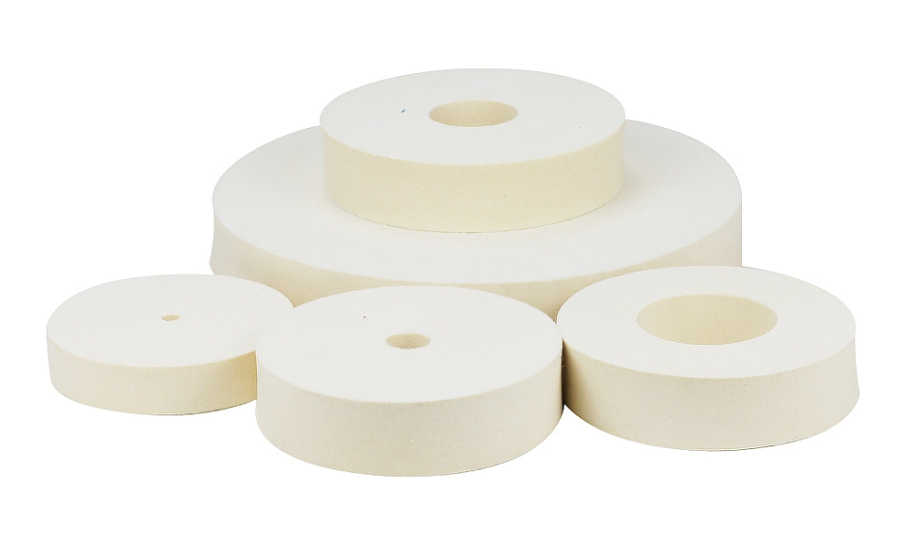
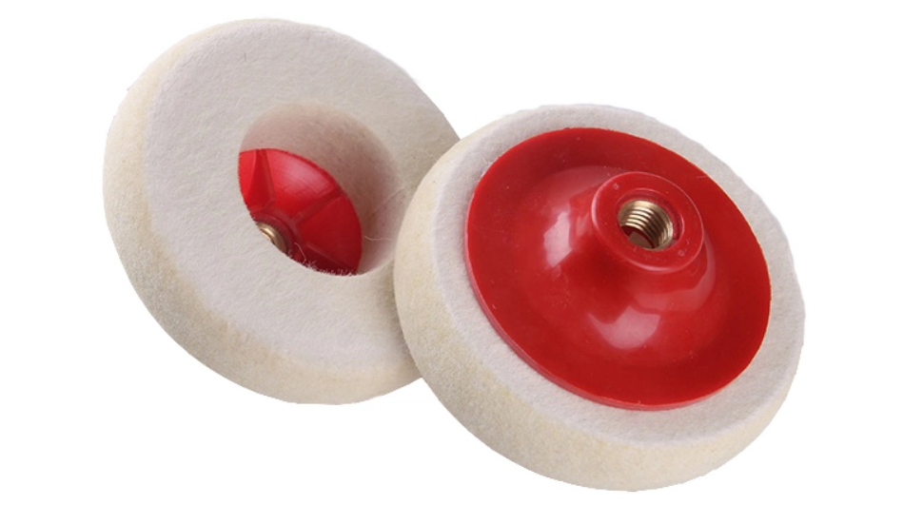
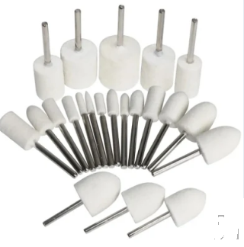
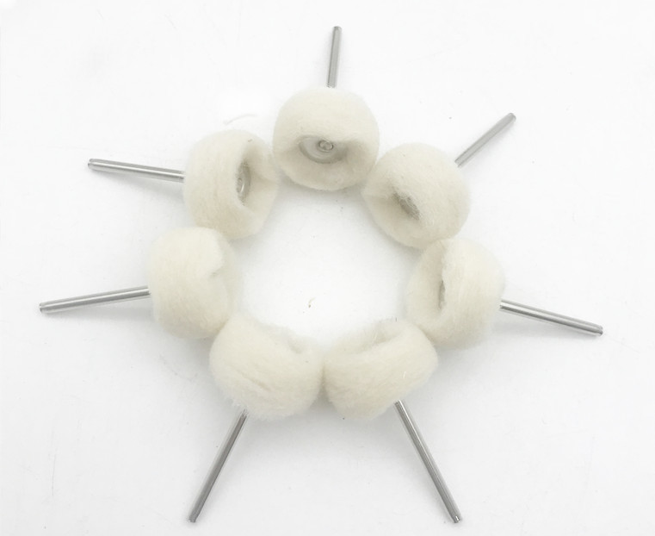
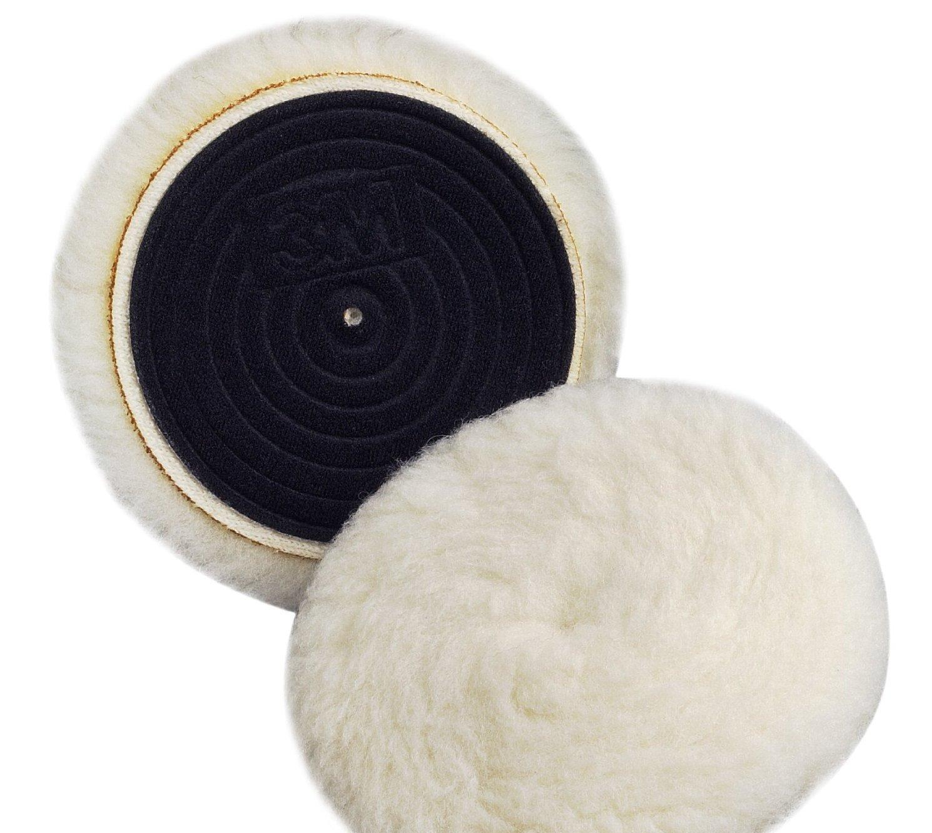
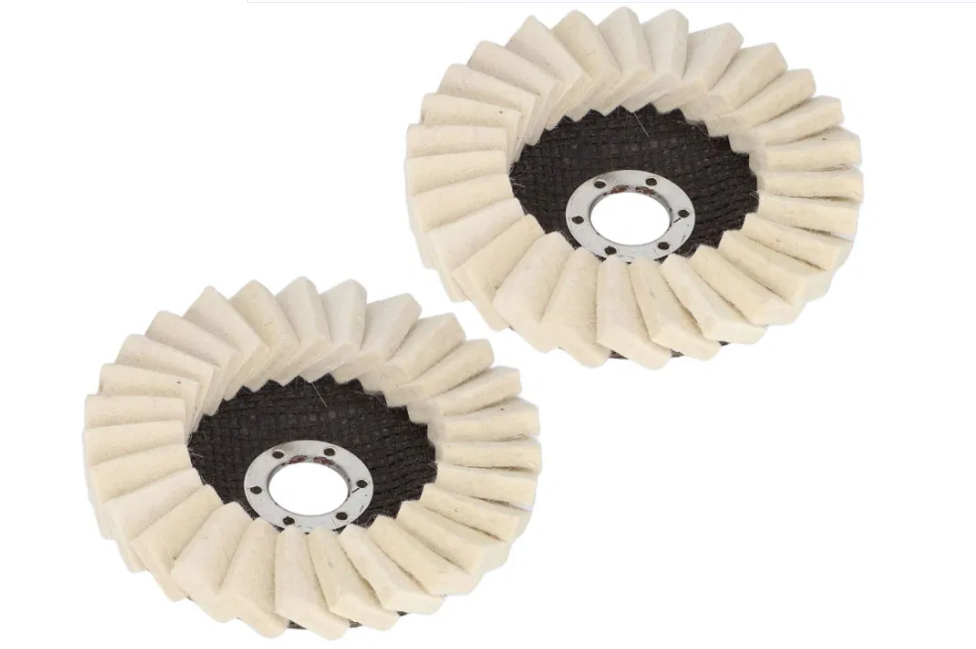
AMANDA INTERNATIONAL PRIVATE LIMITED
FLAT/RM B 5/F GAYLORD COMMERCIAL BUILDING 114-118 LOCKHART ROAD HK
WEBSITE:Https://amanda0a.en.made-in-china.com EMAIL:customer@amanda.net.cn
Ⅶ. POLISHING PRODUCTS

